Slide 1

生物信息学课程模块之 人类基因组与变异 The Human Genome and Variation
授课老师：陈靖祺 副研究员
复旦大学类脑智能科学与研究院
2024年秋季学期

Slide 2
Contents of this module
The human genome and variation
The basics of the human genome
Identification of genomic variants
Interpretation of genome variants
Examples and Review
Genome and Variation
Human Diseases

Slide 3
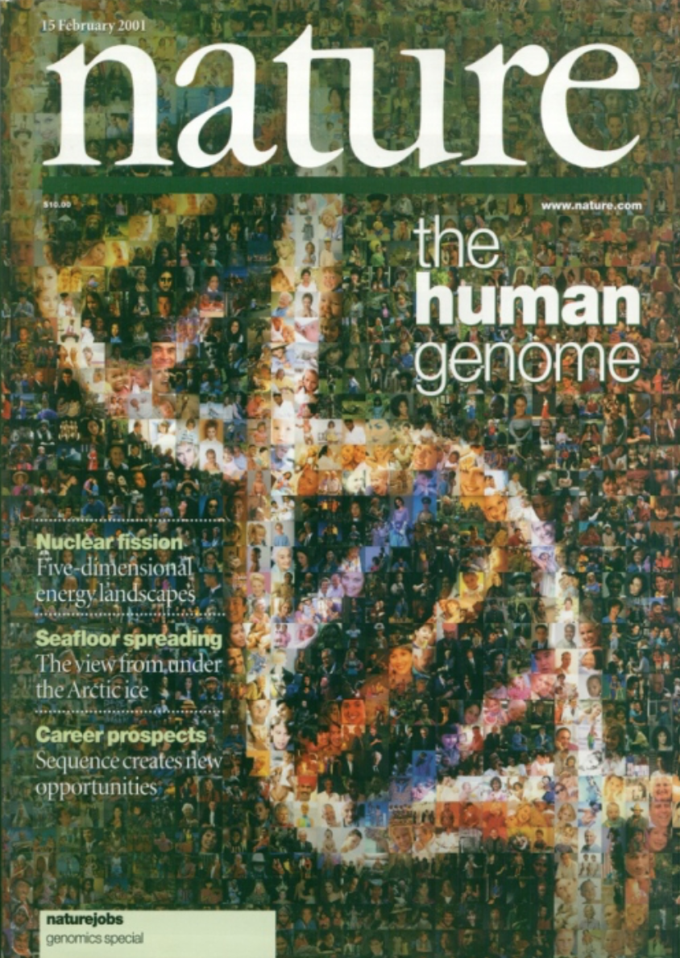
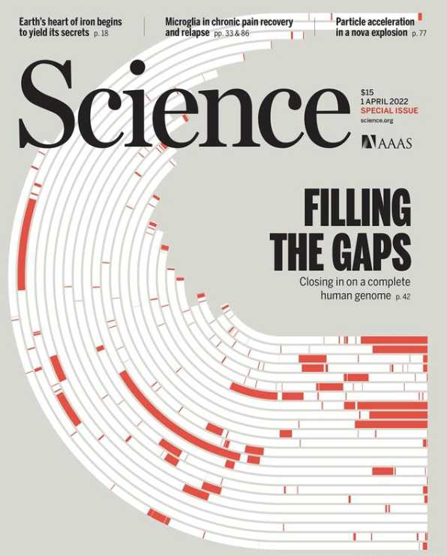
The Basics of the Human Genome
2001
2022
Notes:
（左）人类基因组计划于1985年率先提出，于1990年正式启动的。预计在2005年完成。截止到2003年4月14日，人类基因组计划的测序工作已经完成。其中，2001年人类基因组工作草图的发表（由公共基金资助的国际人类基因组计划和私人企业塞雷拉基因组公司各自独立完成，并分别公开发表）被认为是人类基因组计划成功的里程碑。
（右）A complete telomere-to-telomere (T2T) finished genome is released.

Slide 4
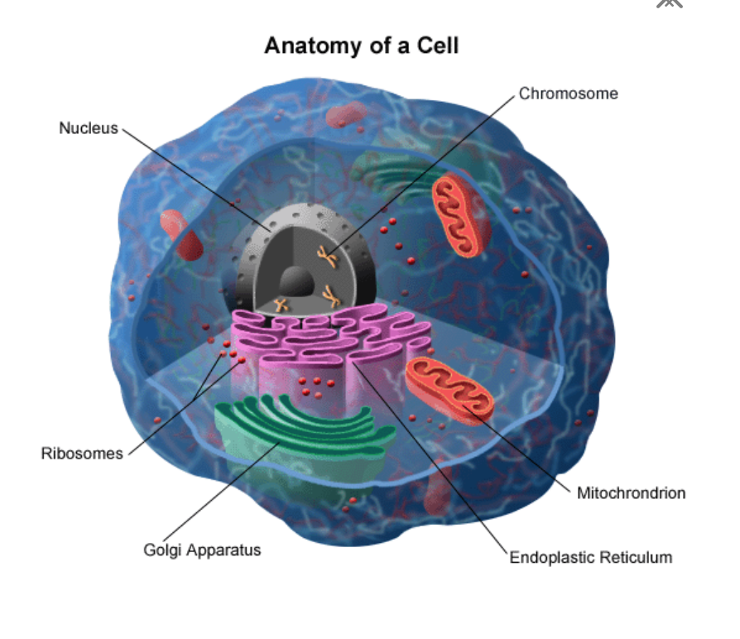
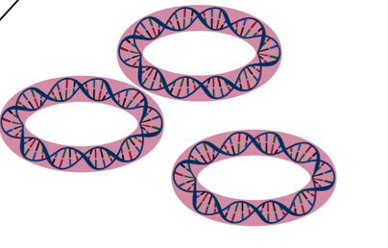
Where is the “genome” located in a typical human cell?
Paternal+
maternal
Maternal
https://www.stanfordchildrens.org/en/topic/default?id=what-are-chromosomes-90-P02116

Slide 5
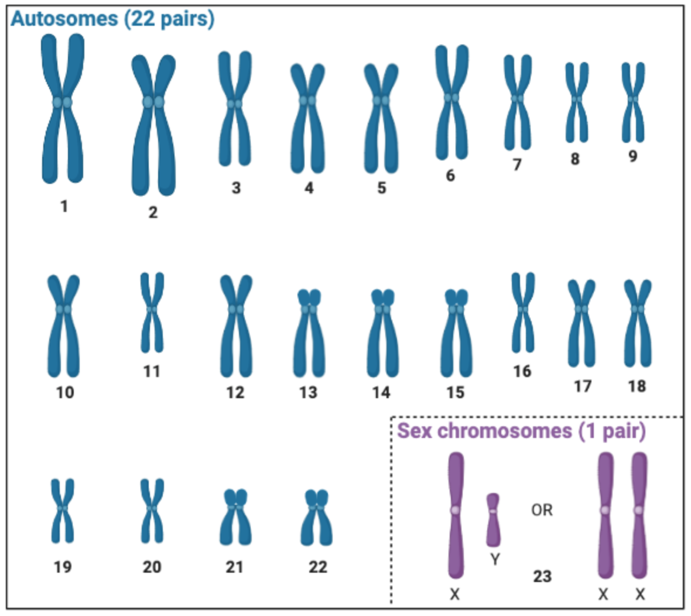
Chromosomes
How many chromosomes are there in a normal human genome?
https://mavis.bcgsc.ca/glossary

Slide 6
Chromosomes
What happens when one has fewer or more chromosomes than usual?
Fewer?
More?

Slide 7
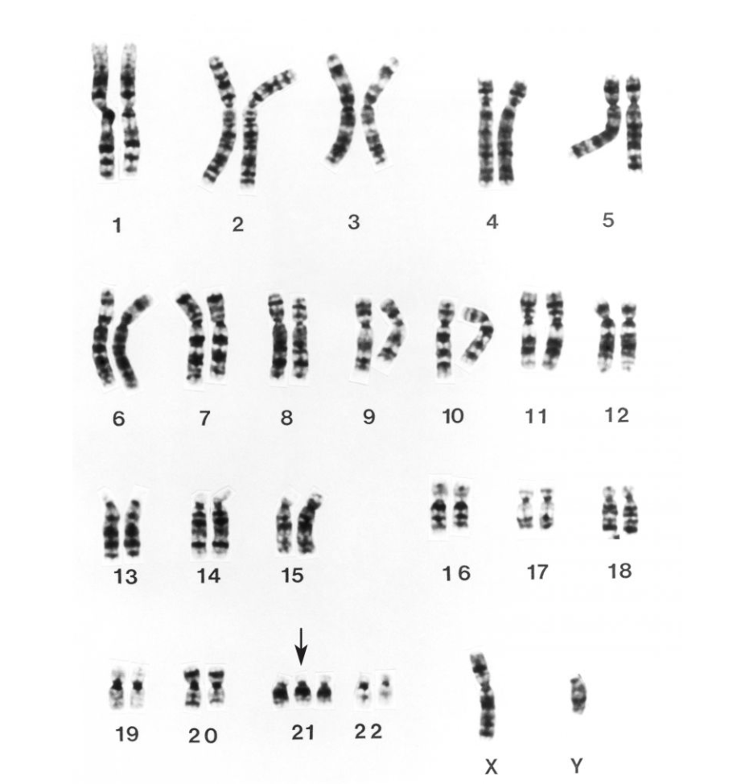
Chromosomal abnormalities
Example: 21 trisomy (Down’s syndrome)
1 among 700 live births (U.S.)
In 95% cases, the probands have 3 copies of Chr21
4% from translocations, such as t(14;21) and t(21;22)
Rare cases: mosaic
Symptoms: lower IQ (20-75), delayed development, facial features, congenital heart disease, shorter life expenctancy (~60)
默沙东 诊疗手册
Notes:
大约 4% 的唐氏综合症病例是由于易位引起的。在平衡易位中，遗传物质与来自另一条非同源染色体的物质交换，染色体计数维持在 46。最常见的易位是 t(14;21)，其中 21 号染色体附着在 14 号染色体上；这是一种不平衡易位，导致染色体计数为 45。约1/2病例患有t（14:21）异位，父母均为正常核型，患儿染色体为新发易位。在另一半中，没有唐氏综合症的父母一方(几乎总是母亲)只有45条染色体，其中一条是t(14;21)。理论上，母亲携带者出生唐氏综合征患儿的比例为1∶3，但由于未知原因，实际的比例为1∶10，父亲携带者引起唐氏综合征患儿的比例为1∶20。如果父亲是携带者，风险仅为1:20。下一个最常见的易位为t（21; 22）。在这些病例中，母亲携带者有1∶10几率出生唐氏综合征患儿，父亲的几率要低许多。

Slide 8
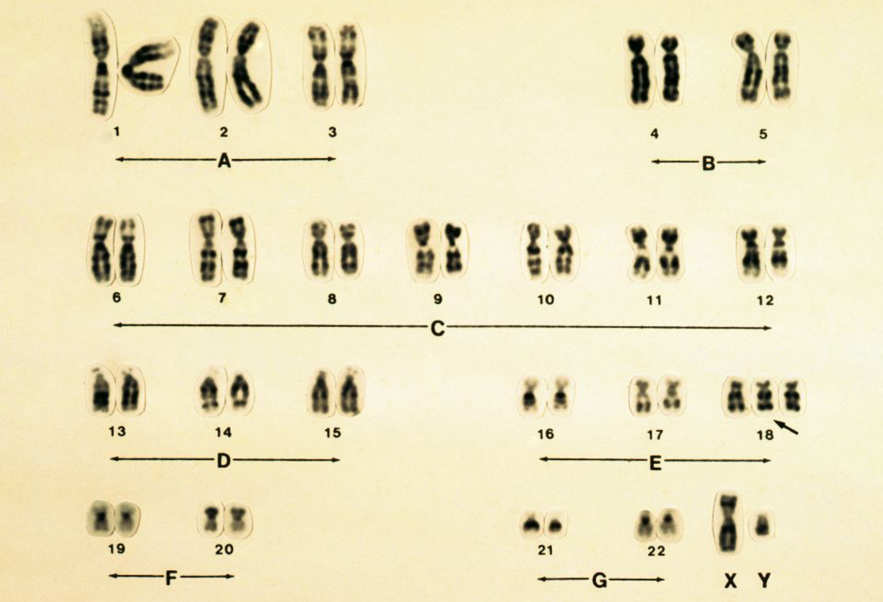
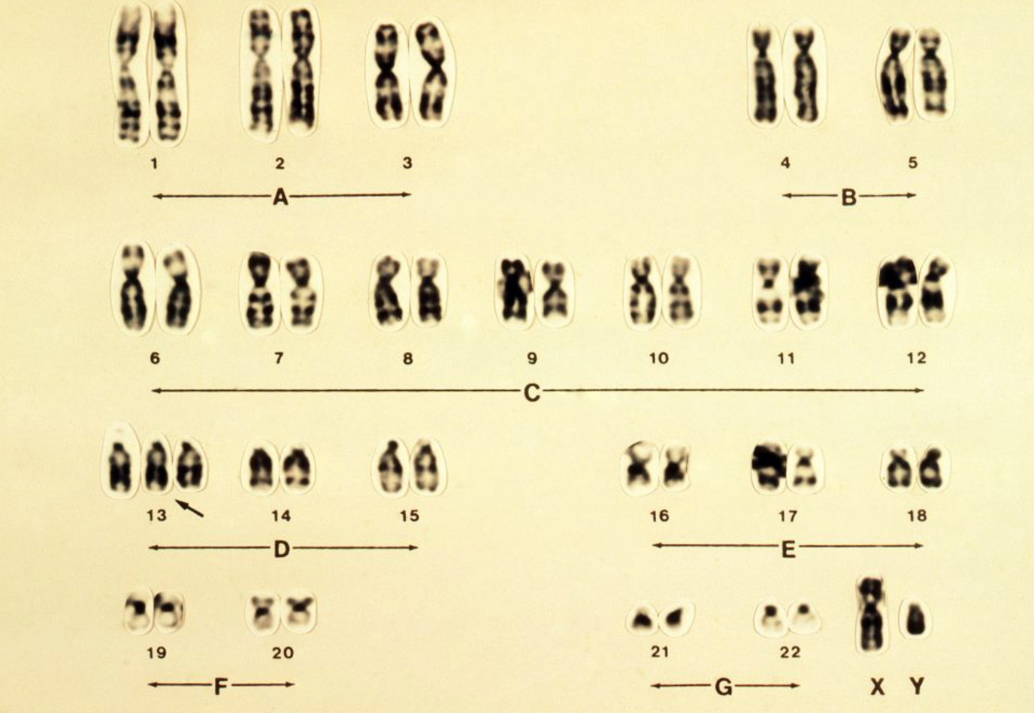
Chromosomal abnormalities
Example: 18 trisomy (Edwards Syndrome)
4.1/10,000 pregnancies
>50% died within 1 week of birth
Only 5-10% survived beyond one year
Example: 13 trisomy (Patau Syndrome)
1.7/10,000 pregnancies
Most died within the first year; recent years some survived >5years
默沙东 诊疗手册

Slide 9
Chromosomal abnormalities
Examples: sex chromosome aneuploidy
47, XXX: 1/1000 females, most without obvious symptoms
Occasionally: delayed speech, learning difficulties, behavioral problems such as ADHD, etc.
45, X: Turner syndrome, 1/2500 live birth girls; short height, failure of the ovaries to develop and heart defects, etc.
Most are infertile, but with fertility treatment some can have children; regular checkups and appropriate care can help most girls and women with Turner syndrome lead healthy, independent lives.
47, XXY: Klinefelter syndrome, 6/10000 live birth boys; taller, abnormal testicles, difficulty in language and reading, diabetes, etc.
Most men with Klinefelter syndrome produce little or no sperm, but assisted reproductive procedures may make it possible for some men with Klinefelter syndrome to father children.
47, XYY: 1/1000 live birth boys; taller, IQ slightly lower (by 10~15), mild behavioral problems, ADHD, etc.; with normal fertility
XYY used to be considered associated with being criminals, but this is no longer supported after broader population studies.
默沙东 诊疗手册
https://www.mayoclinic.org/
Notes:
X染色体异常较常染色体异常症状要轻微。3X染色体的女性体格、智力发育及生育能力正常。相比之下，所有已知的常染色体三体性（例如，13 三体性）都具有临床意义，而且常常具有破坏性的影响。同样，尽管在大多数情况下缺少1个X染色体(X单体)会导致特定综合征(特纳综合征[X单体])，但缺少常染色体总是致命的。

Slide 10
Chromosomal abnormalities
Smaller changes (for part of one or more chromosomes)
Deletions
Duplications
Translocations
Etc.
*These can be roughly called structural variants, which will be discussed in the next chapter.

Slide 11
Chromosomal abnormalities
Ways to detect chromosomal abnormalities
Method | What it detects
Karyotyping | Abnormal chromosome numbers, large structural abnormalities
Fluorescent in Situ Hybridization (FISH) | Copy number variation in limited numbers and regions of chromosomes
Chromosomal Microarray Analysis (CMA), including array-based comparative genomic hybridization (array-CGH) and single nucleotide polymorphism array (SNP-array) | Genome-wide copy number alterations, including micro-deletions/duplications

Slide 12
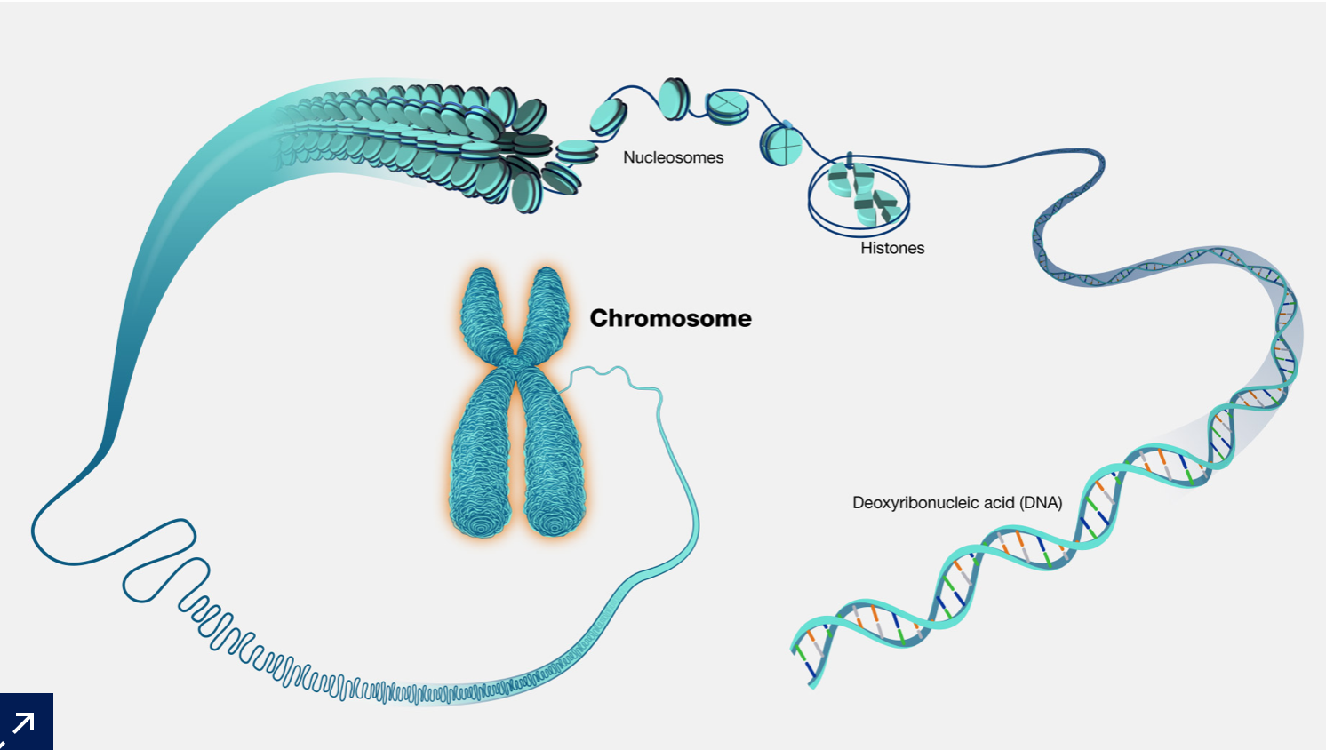
Chromosomes
What makes up a chromosome?
https://www.genome.gov/genetics-glossary/Chromosome

Slide 13
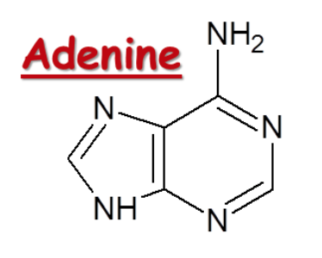
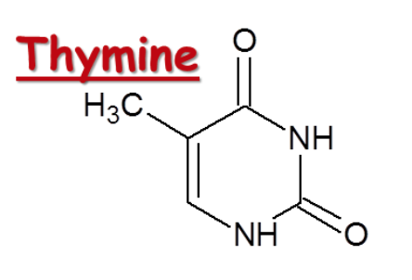
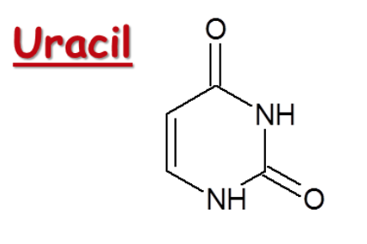
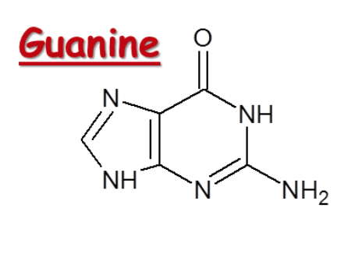
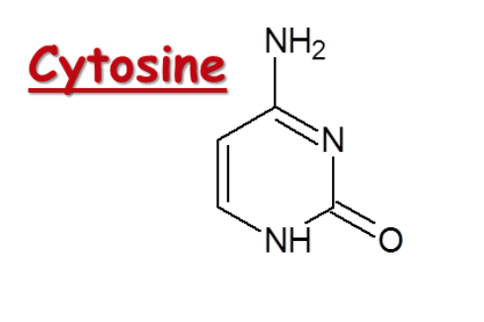
Bases
DNA (Deoxyribonucleic acid)
RNA (Ribonucleic acid)
腺嘌呤
胸腺嘧啶
腺嘌呤
尿嘧啶
鸟嘌呤
胞嘧啶
鸟嘌呤
胞嘧啶
sliderbase.com

Slide 14
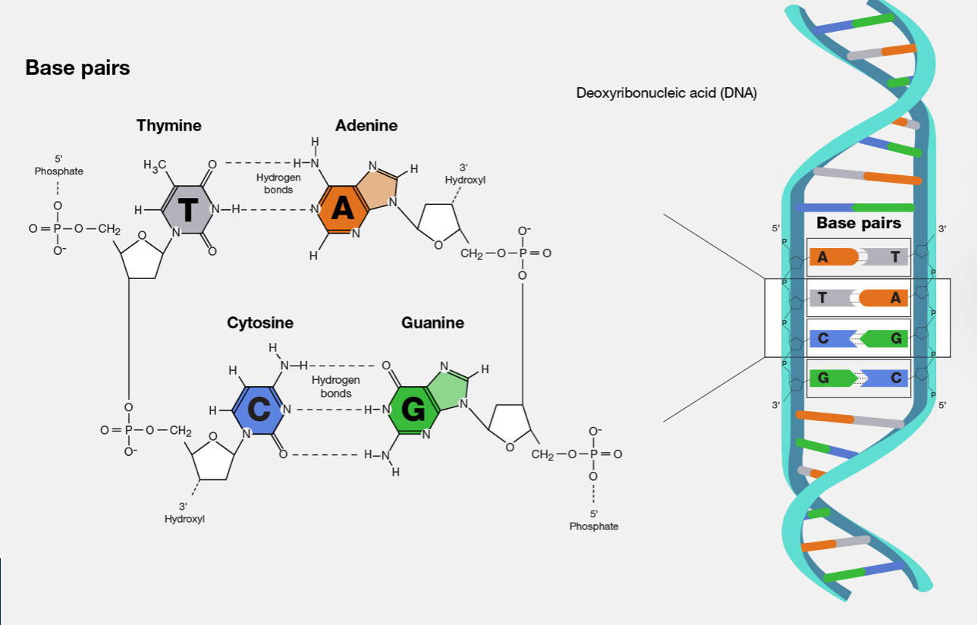
DNA
https://www.genome.gov/genetics-glossary/Base-Pair

Slide 15
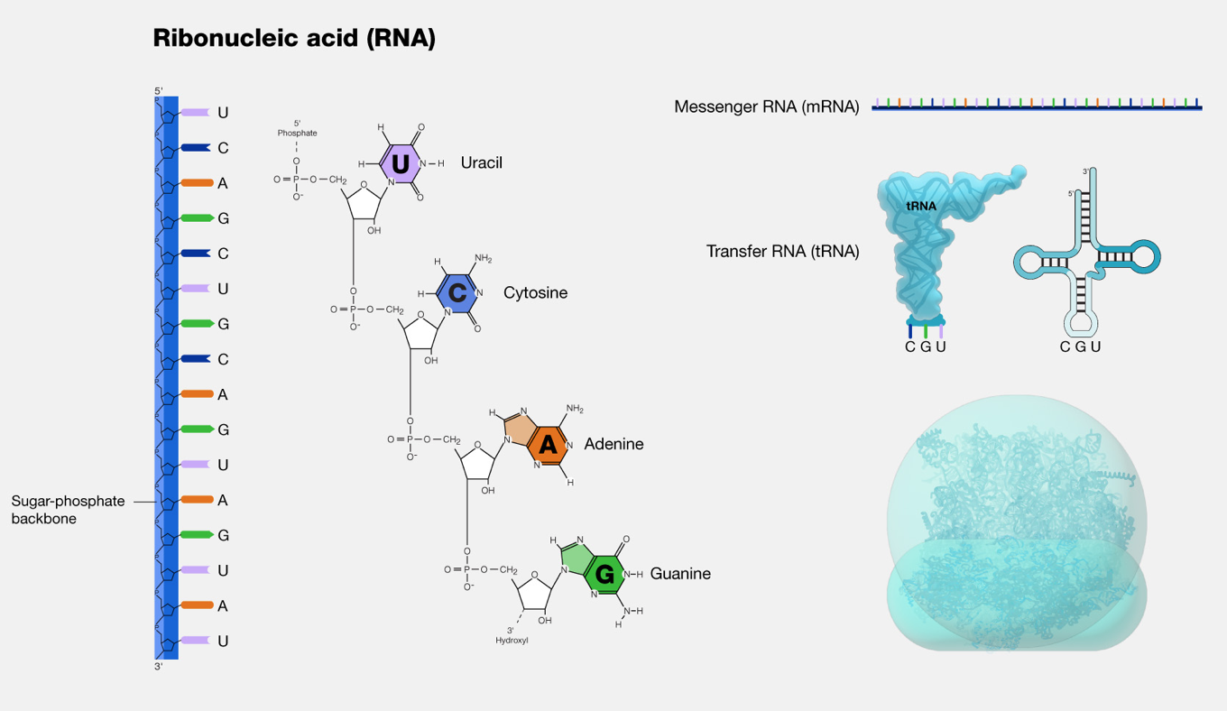
RNA
https://www.genome.gov/genetics-glossary/RNA-Ribonucleic-Acid

Slide 16
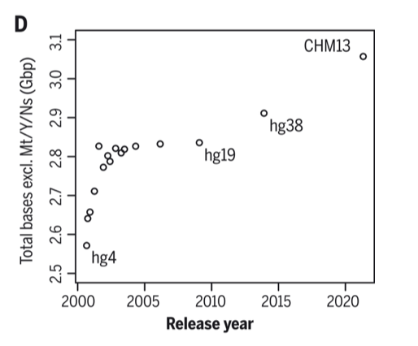
Bases
How many base pairs (bp) are there in a typical human genome?
~ 3 billion bp!
Nurk et al., Science, 2022; DOI: 10.1126/science.abj6987

Slide 17
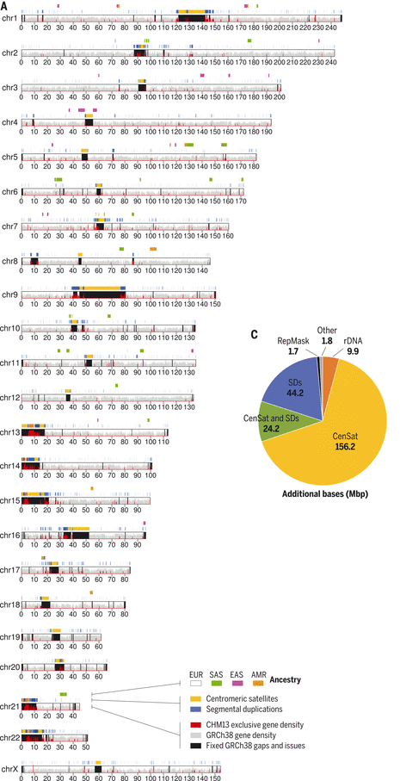
Base pairs in each chromosome
Lengths
Unique vs repeat sequences
Ancestry-specifiicity
Nurk et al., Science, 2022; DOI: 10.1126/science.abj6987

Slide 18
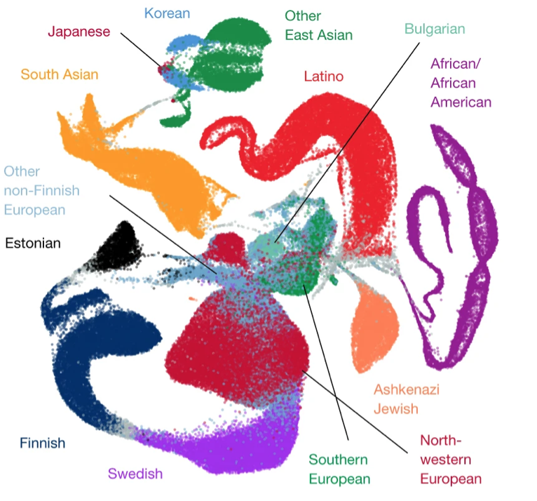
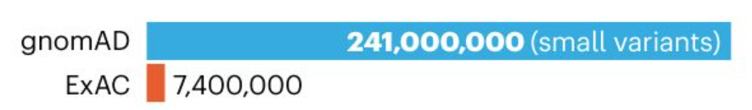
Base variation
“Differences” among the population
Single nucleotide polymorphism (SNP), or single nucleotide variant (SNV)
In most cases, these are benign differences
241 million small genetic variants (single nucleotide variants and short insertion/deletion variants) are detected from 141,456 humans.
443,769 predicted loss-of-function (pLoF) genetic variants in protein-coding genes
https://www.nature.com/immersive/d42859-020-00002-x/index.html
Notes:
(Left) Uniform manifold approximation and projection (UMAP) plot depicting the ancestral diversity of all individuals in gnomAD, using seven principal components. Note that long-range distances in the UMAP space are not a proxy for genetic distance.
The gnomAD papers report 241 million small genetic variants (single nucleotide variants and short insertion/deletion variants) and 335,470 structural variants (DNA rearrangements of at least 50 base pairs), compared with 7.4 million small genetic variants identified in gnomAD’s predecessor, the Exome Aggregation Consortium (ExAC, which did not analyse structural variation).

Slide 19
Base variation
“Pathogenic” variation among the population
Existence of the variant can lead to certain deleterious effects, such as a disease
Usually under selection burden – with a lower frequency in the population
term: minor allele frequency (MAF)
May have functional consequences in molecular levels
Types of pathogenic/likely pathogenic SNVs
Missense
Loss-of-function
Splicing
Regulatory

Slide 20
Base variation
“Pathogenic” variation
Metrics derived from loss-of-function variants
…the loss-of-function transcript effect estimator (LOFTEE), applies stringent filtering criteria from first principles (such as removing terminal truncation variants, as well as rescued splice variants, that are predicted to escape nonsense-mediated decay) to pLoF variants annotated by the variant effect predictor…
Defined as those that introduce a premature stop (stop-gained), shift-reported transcriptional frame (frameshift), or alter the two essential splice-site nucleotides…
pLoF variants (predicted
loss-of-function)
LOFTEE
the 90% upper bound of the confidence interval of the loss-of-function observed/expected ratio, for each gene
pLI
LOEUF
A gene’s intolerance to heterozygous pLoF variation; pLI > 0.9 considered more likely to be pathogenic
Karczewski et al., Nature, 2020; https://doi.org/10.1038/s41586-020-2308-7

Slide 21
Base variation
“Pathogenic” variation
Most variants don’t have direct evidence for their pathogenicity
Especially those that are not pLoF
How to predict and quantify pathogenicity?
Statistically inference
Classic
Machine learning
Deep learning/
Modern AI
* To be discussed in details in later classes!

Slide 22
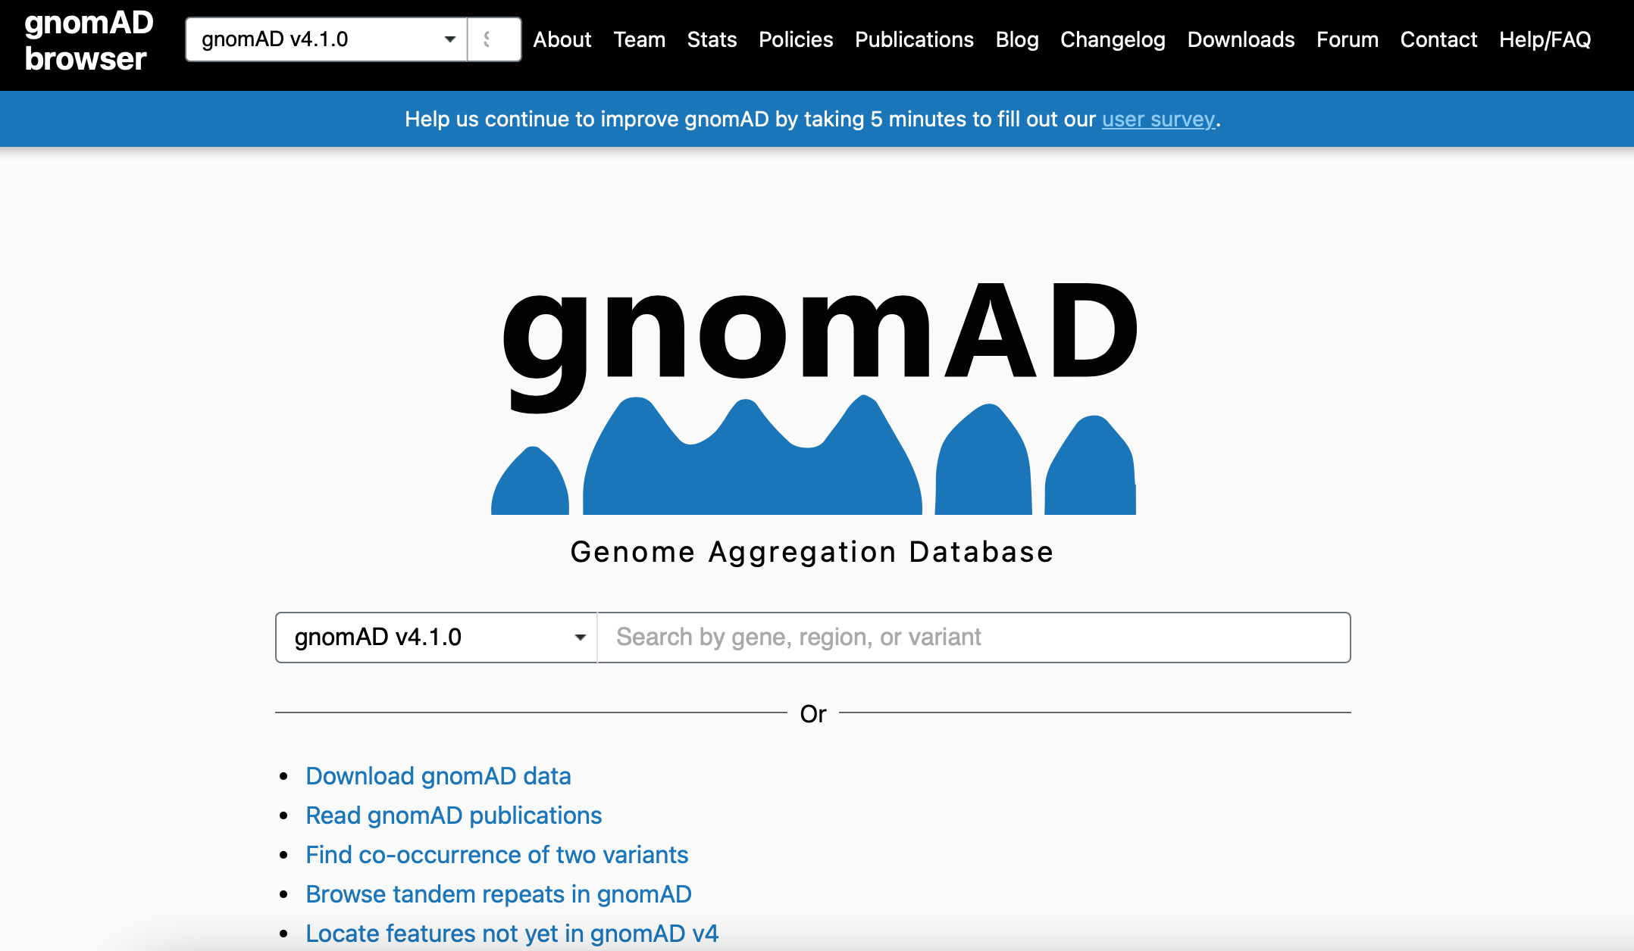
Example of a genome catalogue: The Genome Aggregation Database (gnomAD)
https://gnomad.broadinstitute.org

Slide 23
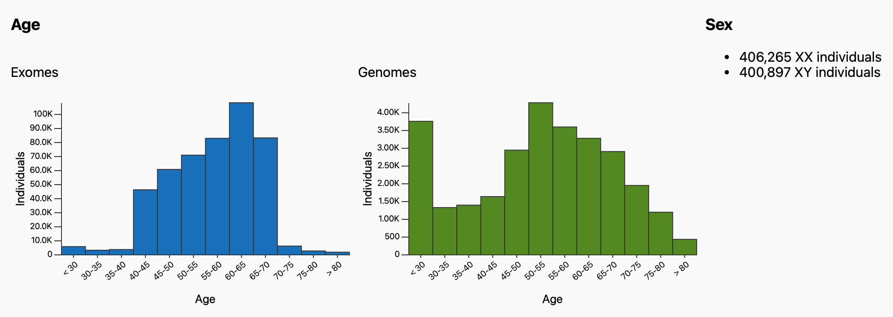
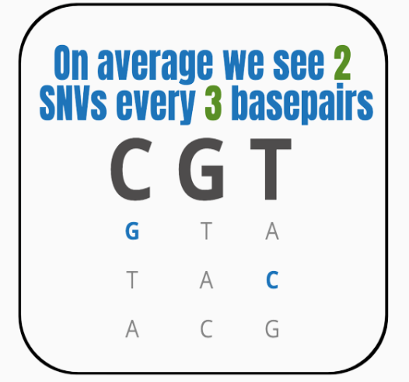
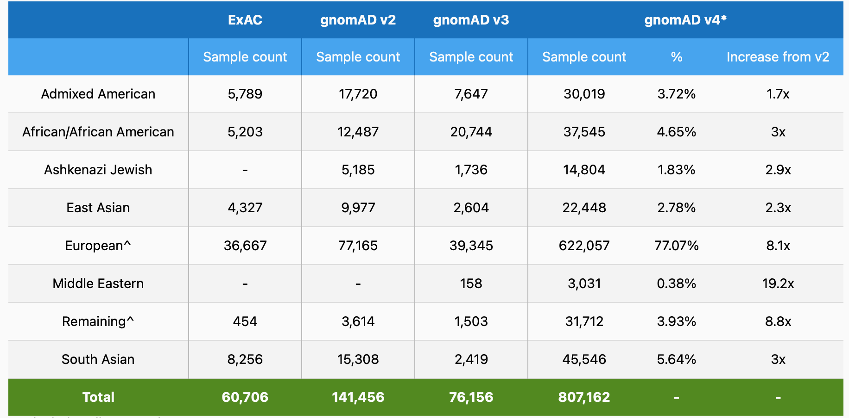
Example of a genome catalogue: The Genome Aggregation Database (gnomAD)
https://gnomad.broadinstitute.org/stats

Slide 24
Genes
The common understanding
A unit of sequence that can be translated into a protein (“coding”)
Conventionally, many people do not consider non-coding genes as genes
The term “gene” may be considered equivalent to “genetics”, or “genome”
The modern definition
A unit of hereditary information that occupies a fixed position (locus) in the genome
Some can be translated into proteins
Some can function without being translated into proteins, e.g. non-coding RNAs
Genes are only a small part of the genome
Genes belong to the subjects of genetic studeis
https://www.britannica.com/science/gene

Slide 25
Genes: types
Protein-coding gene: Genes that contains an open reading frame (ORF).
IG gene: Immunoglobulin gene that undergoes somatic recombination.
Long non-coding RNA (lncRNA) gene: A non-coding gene >200bp in length
ncRNA gene: A non-coding gene, such as microRNA, tRNA, rRNA, etc.
Pseudogene: A gene that has homology to known protein-coding genes but contain a frameshift and/or stop codon(s) which disrupts the ORF.
TR gene: T cell receptor gene that undergoes somatic recombination.
A great variety of genes
http://mart.ensembl.org/info/genome/genebuild/biotypes.html

Slide 26
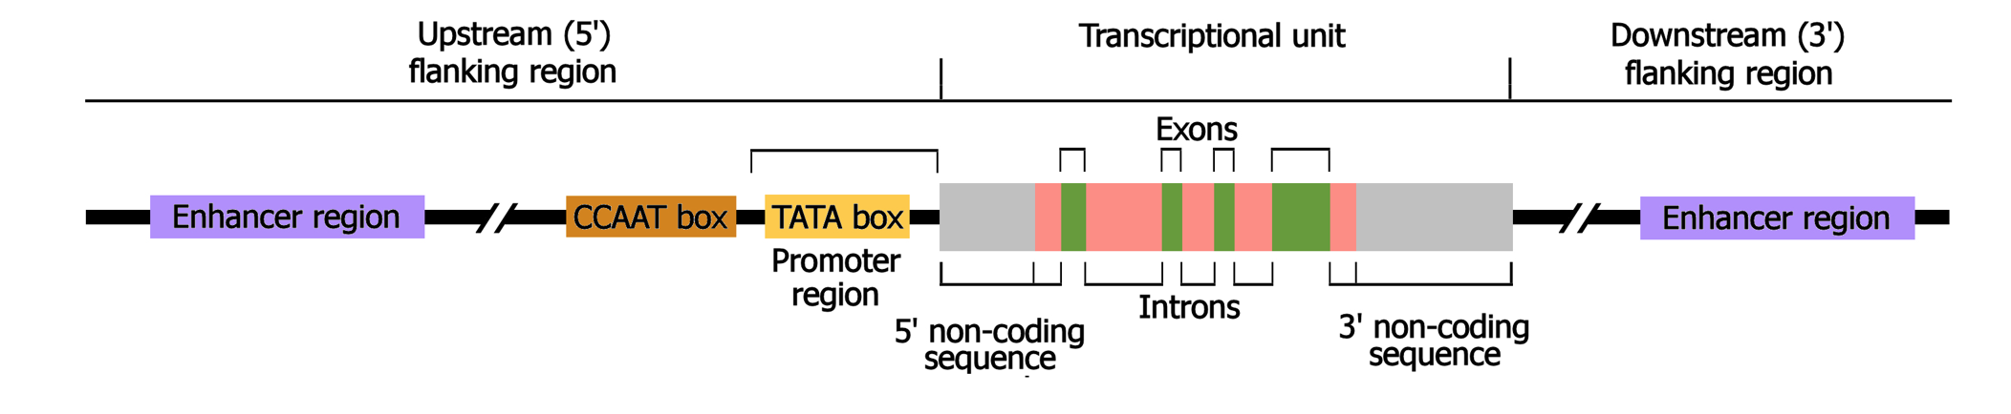
Genes: structure
A typical protein-coding gene
https://www.mun.ca/biology/scarr/Organization_of_a_eukaryotic_gene.html

Slide 27
Genes
How does a typical protein-coding gene function?
Transcribed
RNA
Translated
Protein
What do RNAs and Proteins do?

Slide 28
The central dogma of molecular biology
Replication, Repair
Regulate
Regulate
DNA
Transcription
RNA
Translation
Protein
Reverse
Transcription
Replicate, Process, Regulate

Slide 29
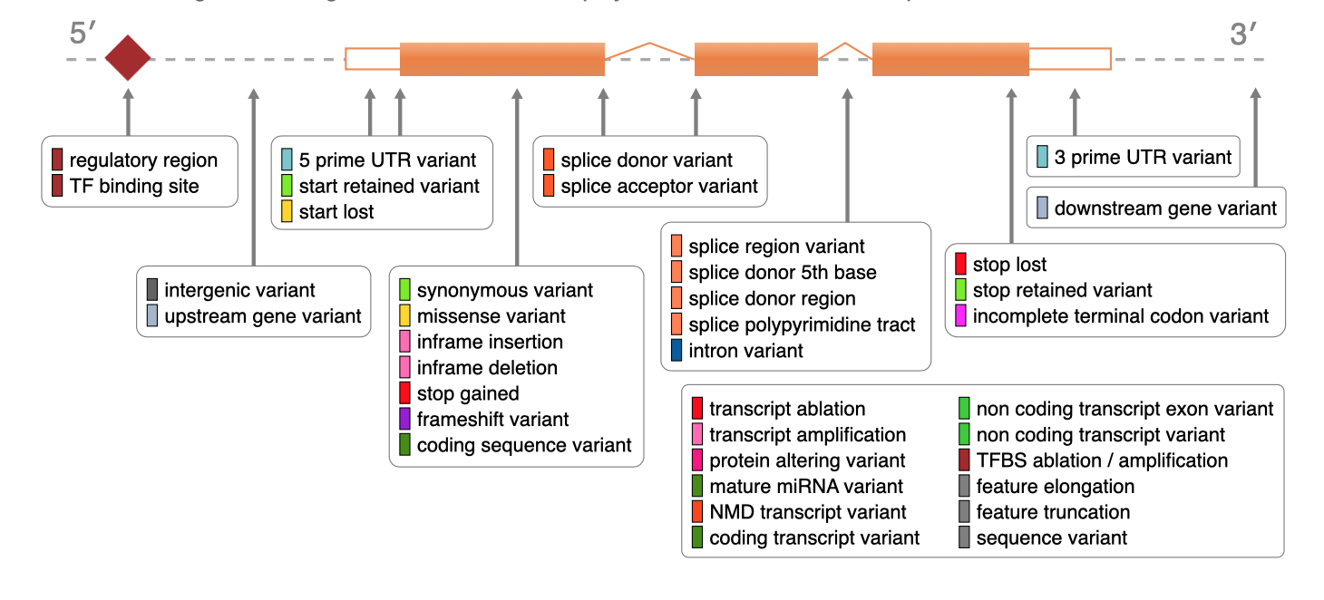
Genes: consequences of variants
For a typical protein-coding gene:
http://mart.ensembl.org/info/genome/variation/prediction/predicted_data.html

Slide 30
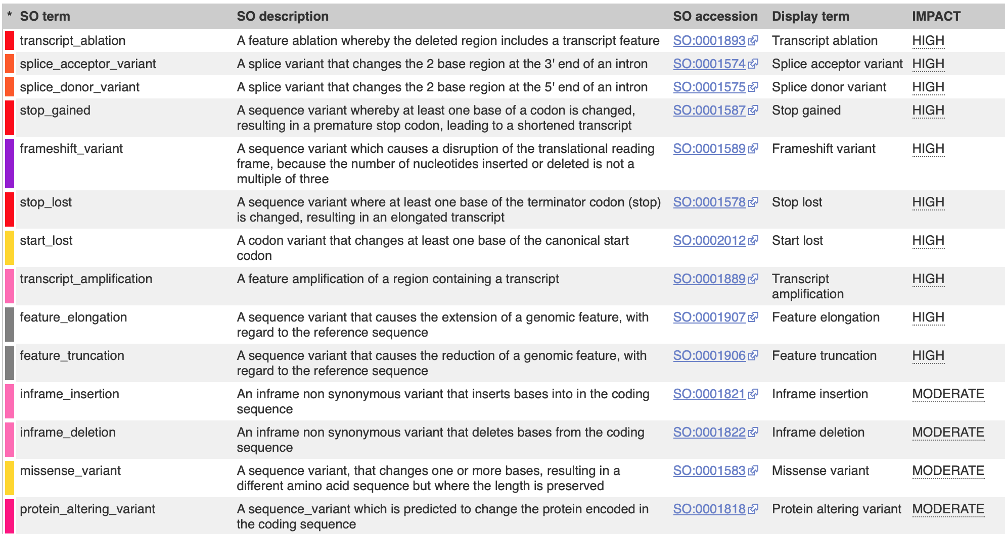
Genes: consequences of variants
http://mart.ensembl.org/info/genome/variation/prediction/predicted_data.html

Slide 31
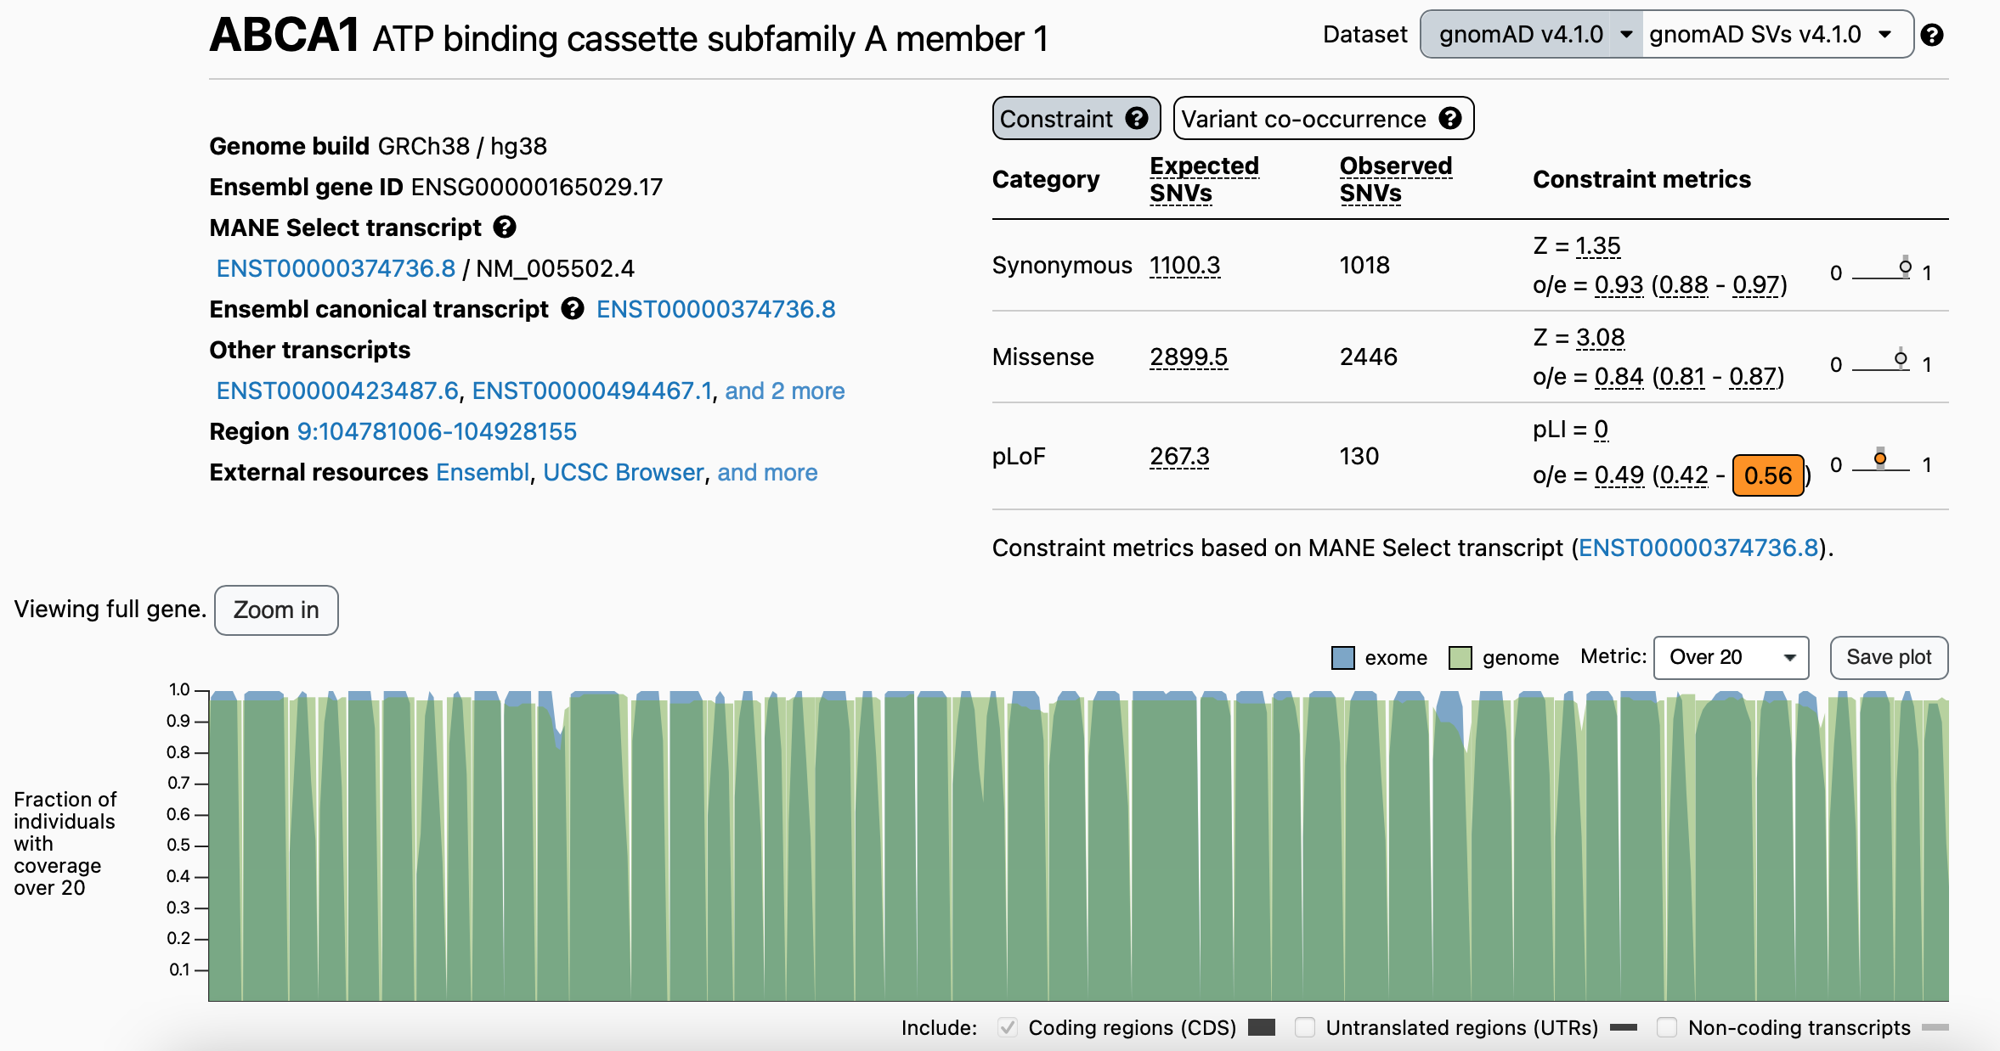
Example of variants in a gene in gnomAD
https://gnomad.broadinstitute.org, search for “ABCA1” gene

Slide 32
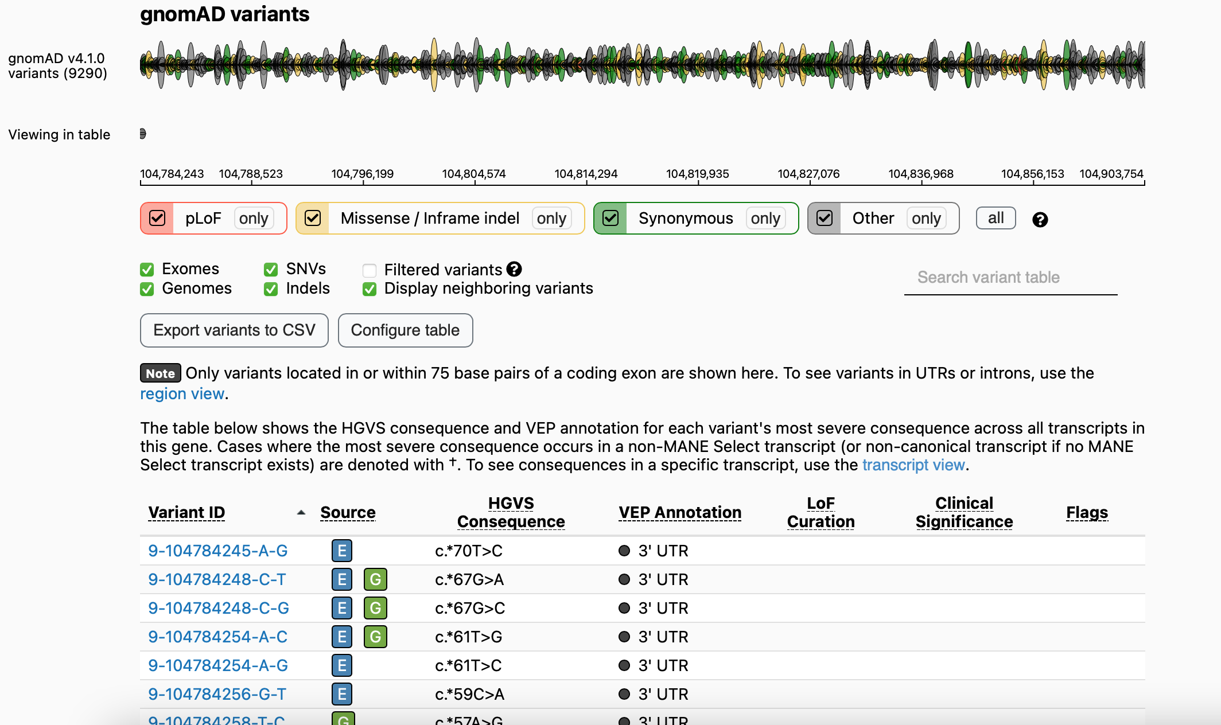
Example of variants in a gene in gnomAD
https://gnomad.broadinstitute.org, search for “ABCA1” gene, and scroll down

Slide 33
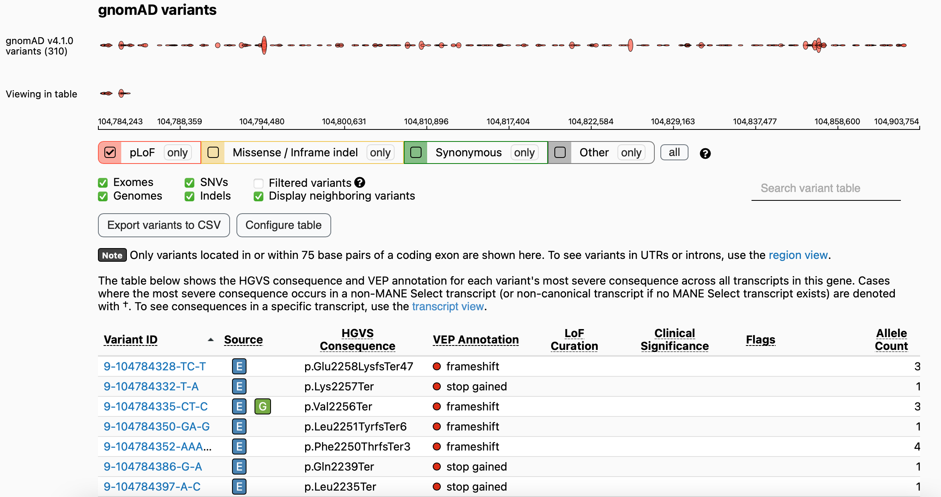
Example of variants in a gene in gnomAD
https://gnomad.broadinstitute.org, search for “ABCA1” gene; scroll down, and select “pLoF only”

Slide 34
Genic vs Intergenic regions
Genic regions: promoter (various definitions) -> Transcriptional start site (TSS) -> exons/introns/UTRs -> Transcriptional end site (TES)
Intergenic regions: the genomic regions between/outside of genic regions
TSS
TES
Genic region
https://www.mun.ca/biology/scarr/Organization_of_a_eukaryotic_gene.html

Slide 35
Coding vs Non-coding regions
Point out the coding regions in this diagram:
Advanced Questions:
Are coding regions and noncoding regions fixed?
When/how do they change?
https://www.mun.ca/biology/scarr/Organization_of_a_eukaryotic_gene.html

Slide 36
Pseudogenes
Definition
Genomic sequences that resemble known genes but cannot produce functional proteins. ¹
A genomic DNA sequence that looks like a mutated or truncated version of a known functional gene. ²
How do pseudogenes form?
The process of new gene generation, such as gene duplication, followed by the subsequent accumulation of disabling mutations. ¹
How many pseudogenes are there in the human genome?
12,000-20,000 ²
1. Nature Scitable, https://www.nature.com/scitable/topicpage/origins-of-new-genes-and-pseudogenes-835/
2. Salmena, Methods in Molecular Biology. 2021:2324:3-18. doi: 10.1007/978-1-0716-1503-4_1.

Slide 37
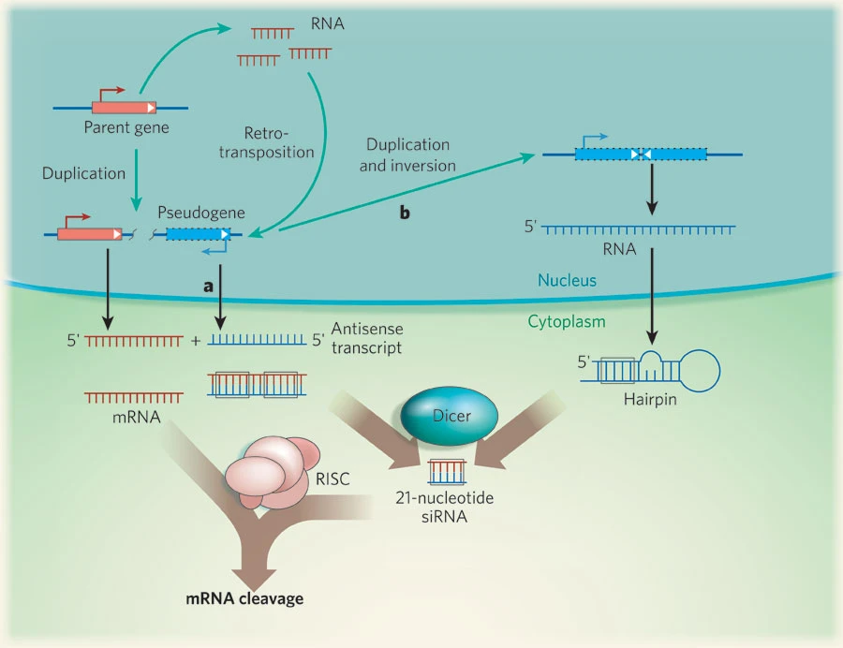
Psudogenes
Do psudogenes have function? How?
YES
They might live on as regulatory RNAs:
For example, these sequences can be transcribed to regulate parental genes through siRNAs.
Sasidharan and Gerstein, Nature, 453, pages 729–731 (2008)

Slide 38
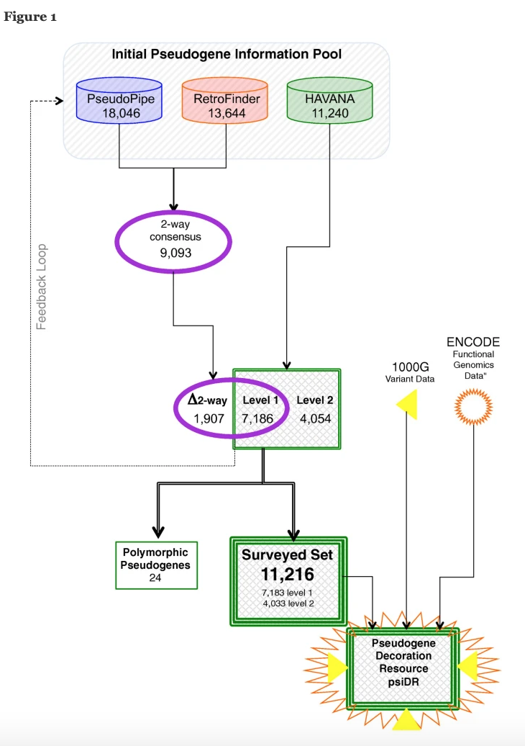
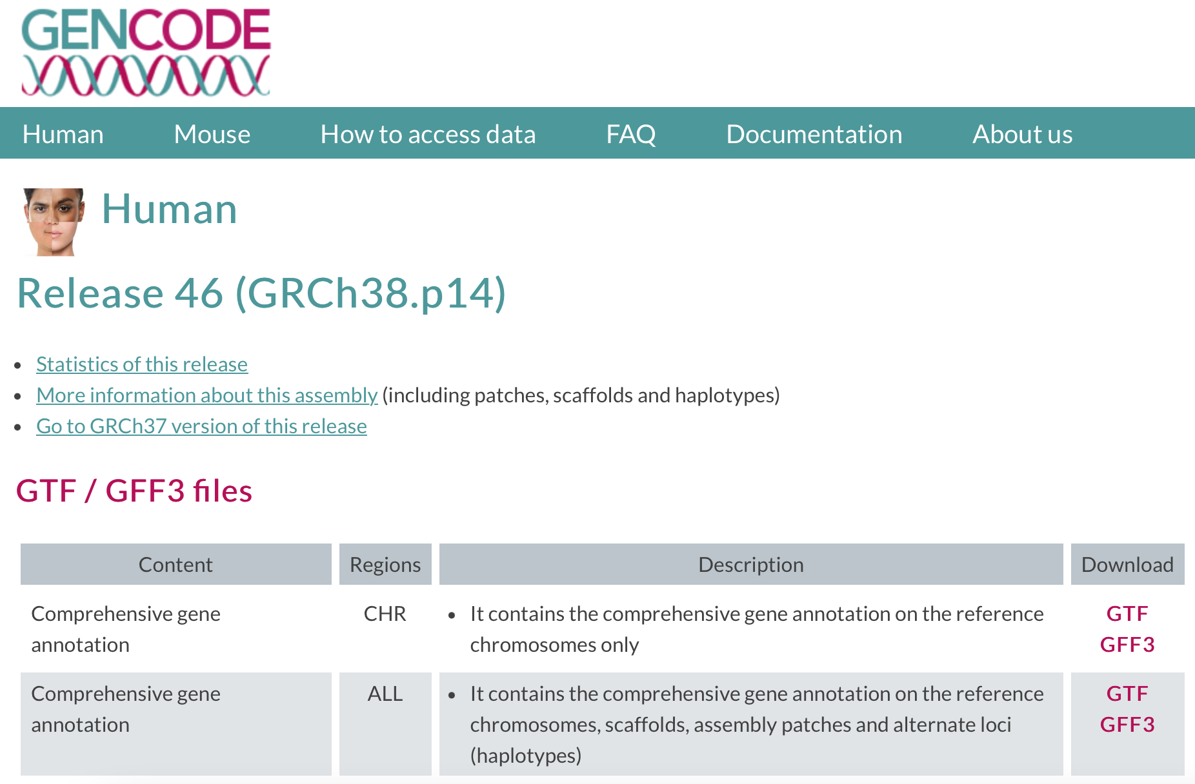
Pseudogenes
The annotation of pseudogenes
GENCODE
Pei et al., Genome Biology, 2012; DOI: https://doi.org/10.1186/gb-2012-13-9-r51
Notes:
Pseudogene annotation flowchart. A flowchart to describe the GENCODE pseudogene annotation procedure and the incorporation of functional genomics data from the 1000 Genomes (1000G) project and ENCODE. This is an integrated procedure including manual annotation done by the HAVANA team and two automated prediction pipelines: PseudoPipe and RetroFinder. The loci that are annotated by both PseudoPipe and RetroFinder are collected in a subset labeled as '2-way consensus', which is further intersected with the manually annotated HAVANA pseudogenes. The intersection results in three subsets of pseudogenes. Level 1 pseudogenes are loci that have been identified by all three methods (PseudoPipe, RetroFinder and HAVANA). Level 2 pseudogenes are loci that have been discovered through manual curation and were not found by either automated pipeline. Delta 2-way contains pseudogenes that have been identified only by computational pipelines and were not validated by manual annotation. As a quality control exercise to determine completeness of pseudogene annotation in chromosomes that have been manually annotated, 2-way consensus pseudogenes are analyzed by the HAVANA team to establish their validity and are included in the manually annotated pseudogene set if appropriate. The final set of pseudogenes is compared with functional genomics data from ENCODE and genomic variation data from the 1000 Genomes project.

Slide 39
Noncoding RNA genes (ncRNA genes)
Types (based on non-coding gene annotation) | (Possible) Function
transfer RNA (tRNA) | Carrying amino acids during protein synthesis
ribosomal RNA (rRNA) | Part of the protein-synthesizing organelle known as a ribosome
small cytoplasmic RNA (scRNA) | Cellular processes outside the nucleus
small nuclear RNA (snRNA) | RNA processing and splicing
small nucleolar RNA (snoRNA) | rRNA modification, alternative splicing regulation, and RNA expression level regulation, and synthesis of telomeric DNA
microRNA precursors (miRNA) | RNA expression level regulation
Long non-coding RNAs (lncRNA) | a variety of biological functions (https://www.ncbi.nlm.nih.gov/pmc/articles/PMC3540756/)
Others | -

Slide 40
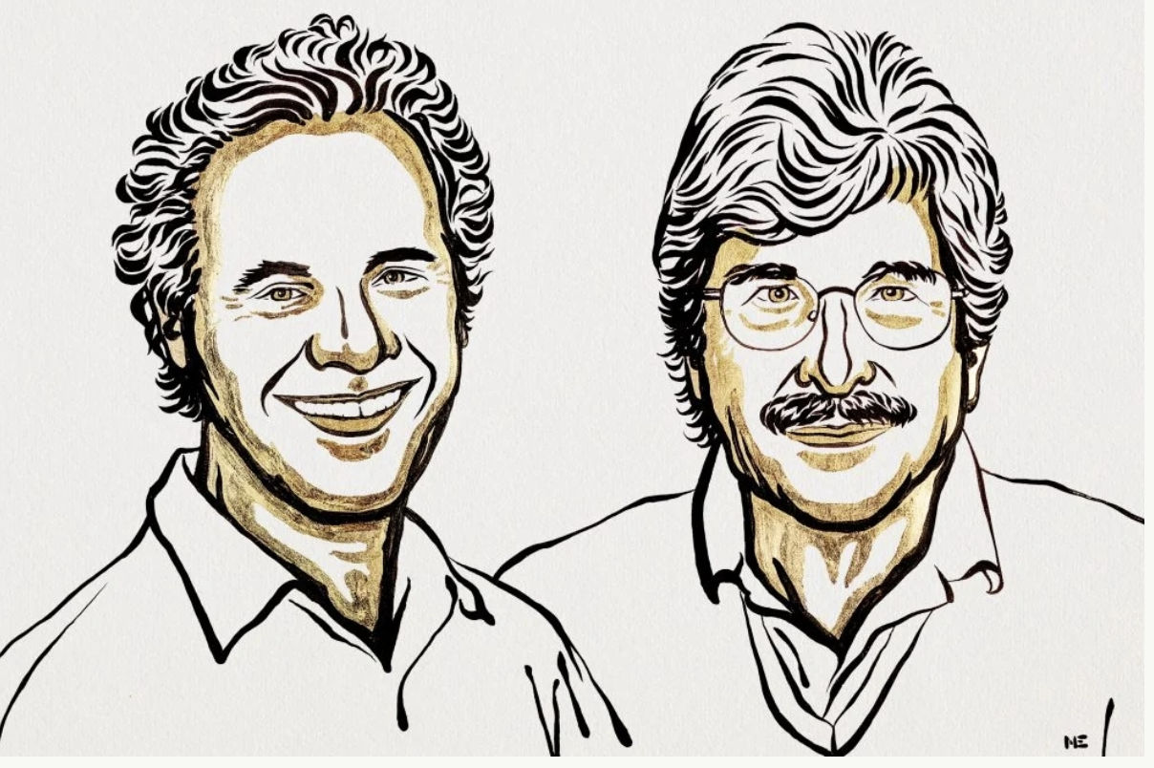
2024 Nobel Prize in Medicine awarded for microRNA discovery
Drs Victor Ambros and Gary Ruvkun
https://english.jschina.com.cn/PhotoGallery/202410/t20241008_8405211.shtml
https://m.thepaper.cn/newsDetail_forward_28960224
Notes:
他们发现了microRNA，这是一类新的微小RNA分子，在基因调控中起着至关重要的作用。他们的突破性发现揭示了一种全新的基因调控原理，这种原理对包括人类在内的多细胞生物至关重要。现在已经知道，人类基因组编码超过1000个microRNAs。他们的惊人发现揭示了基因调控的一个全新维度。事实证明，microRNA对生物体的发育和功能至关重要。
我们身体中的器官和组织由多种不同的细胞类型组成，它们的DNA中都储存着相同的遗传信息。然而，这些不同的细胞会表达出独特的蛋白质组合。
那么，这些差异是如何产生的呢？
答案在于基因调控（gene regulation），它使得每个细胞只选择与自身相关的指令。这能确保每种细胞类型中只有正确的一组基因处于活跃状态。
Victor Ambros 和 Gary Ruvkun 对不同类型的细胞如何发育感兴趣。他们发现了一类之前未知的RNA类型——microRNA（简称miRNA），这种内源性的RNA分子在基因调控中扮演着至关重要的角色。

Slide 41
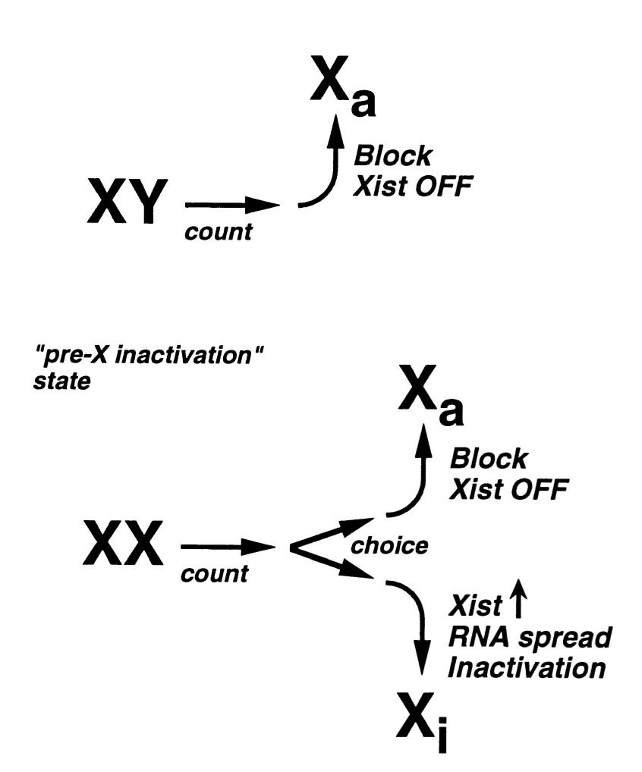
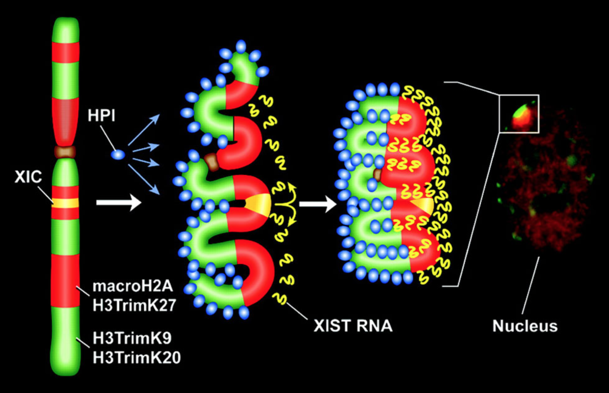
ncRNA
Example
lncRNA XIST (X Inactive Specific Transcript)
Willard, Cell, 1996; DOI: https://doi.org/10.1016/S0092-8674(00)80071-9
Chadwick and Willard, PNAS, 2004; DOI: https://doi.org/10.1073/pnas.0408021101

Slide 42
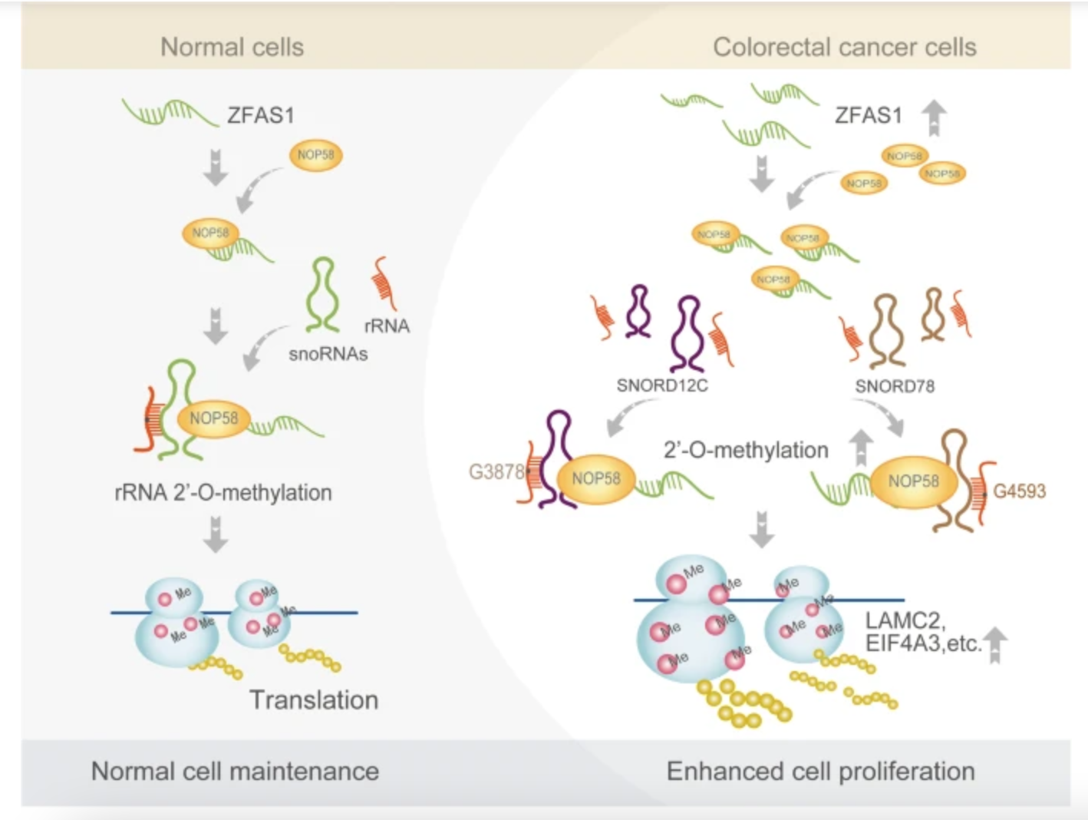
ncRNA
Example
lncRNA-snoRNA-rRNA interaction: ZFAS1 – NOP58 – rRNA 2’-O-methylation
Wu et al., Molecular Cancer, 2020; DOI: https://doi.org/10.1186/s12943-020-01201-w

Slide 43
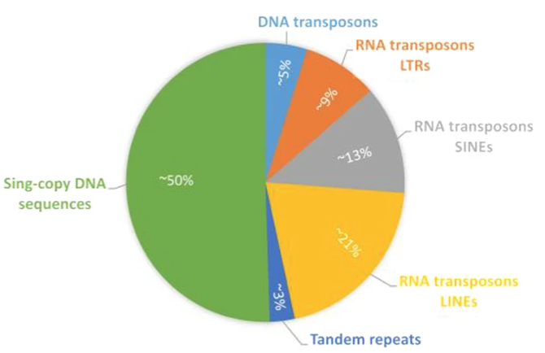
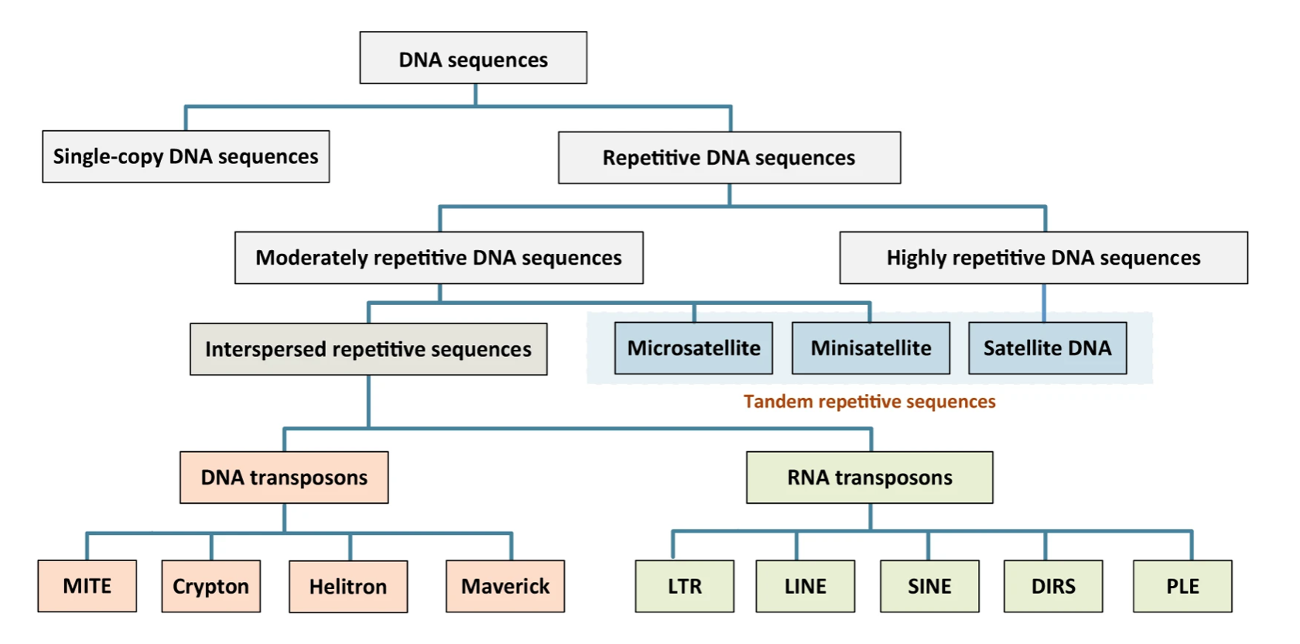
Repeats
What are repeats?
“Repetitive DNA sequences (repeats) are patterns of nucleic acids that occur in multiple copies throughout the genome.”
Half of the human genome!
Liao et al., Communications Biology, 2023; DOI: https://doi.org/10.1038/s42003-023-05322-y
Notes:
与 unique sequence相对应：unique sequence通常包括我们之前讲到的protein coding genes, ncRNA, 等等

Slide 44
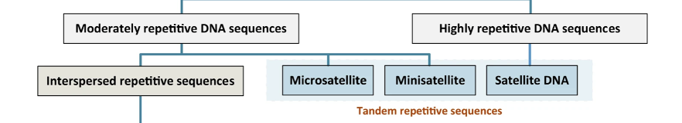
Tandem repeats (TR)
TR include moderately repetitive sequences (microsatellite and minisatellite), and highly repetitive sequences (satellite DNA in and near centromeres and telomeres).
TR can also be categorized into
homopolymers (1-bp motifs)
short tandem repeats (STRs; 2–6-bp motifs)
variable number tandem repeats (VNTRs; >6-bp motifs)
Liao et al., Communications Biology, 2023; DOI: https://doi.org/10.1038/s42003-023-05322-y
Dolzhenko et al., Nature Biotechnology, 2024; DOI: https://doi.org/10.1038/s41587-023-02057-3

Slide 45
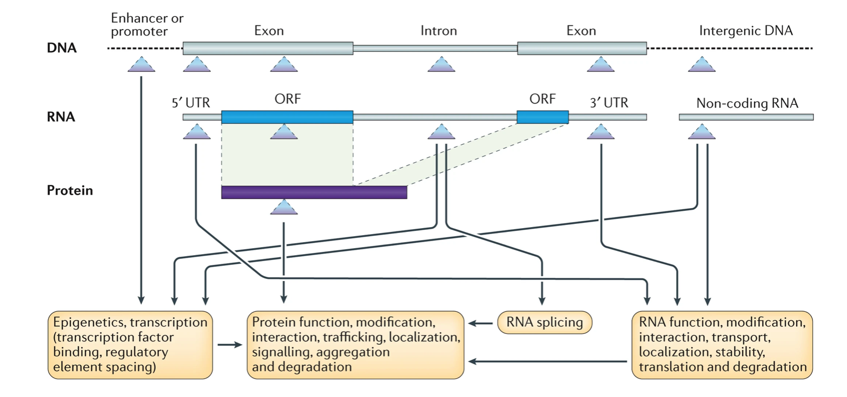
Tandem repeats (TR): impacts
Based on their location relative to genes, TR variants can have diversed impacts on the structures of DNA, RNA, and proteins.
Hannan, Nature Reviews Genetics, 2018; DOI: https://doi.org/10.1038/nrg.2017.115
Notes:
Depending on their location within or between genes, tandem repeats, which are represented here by triangles, can have a variety of effects in healthy organisms at the DNA, RNA and protein levels. Tandem repeats in enhancers or promoters, as well as non-coding RNAs generated from tandem repeats, can affect epigenetic modifications and gene transcription, including transcriptional modulation via altered transcription factor binding. Tandem repeats may also be affected via the modulation of DNA methylation, chromatin states and non-coding RNA structure and function. Tandem repeats in 5′ or 3′ untranslated regions (UTRs) can affect RNA metabolism, including the transport, stability and translation of RNA. The subset of tandem repeats located in open reading frames (ORFs) can be translated into amino acid repeats, including homopeptides and longer motifs, within proteins, thus potentially affecting various aspects of protein structure and/or function. Finally, tandem repeats in introns can modify RNA splicing, which leads to changes at the protein level.

Slide 46
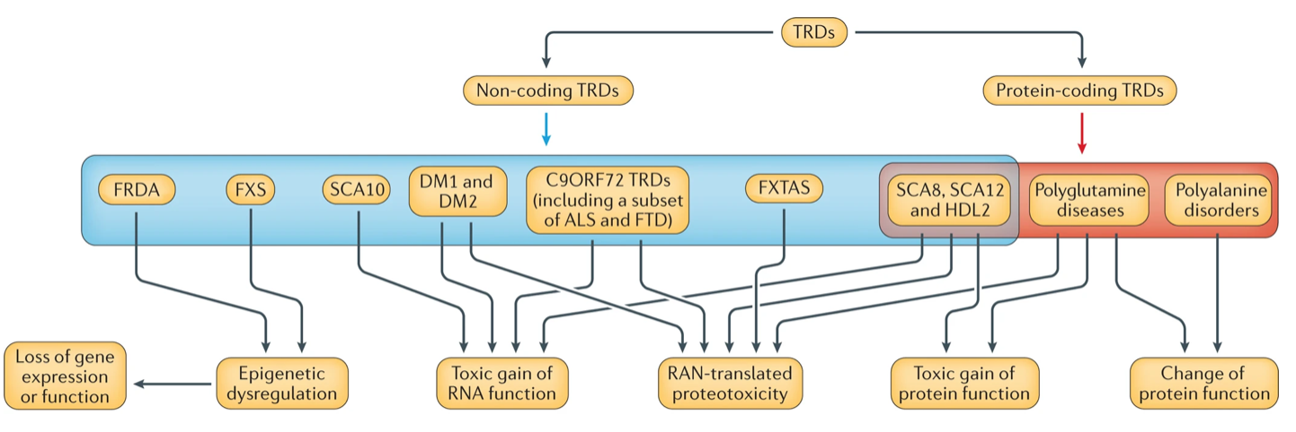
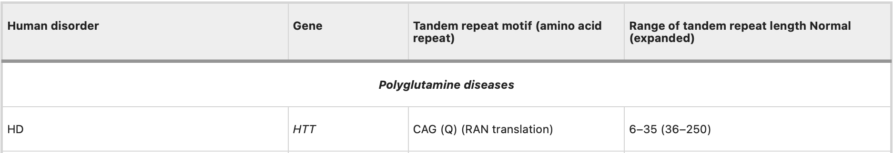
Tandem repeats (TR): in human diseases
TRD (tandem repeat disorders)
Hannan, Nature Reviews Genetics, 2018; DOI: https://doi.org/10.1038/nrg.2017.115

Slide 47
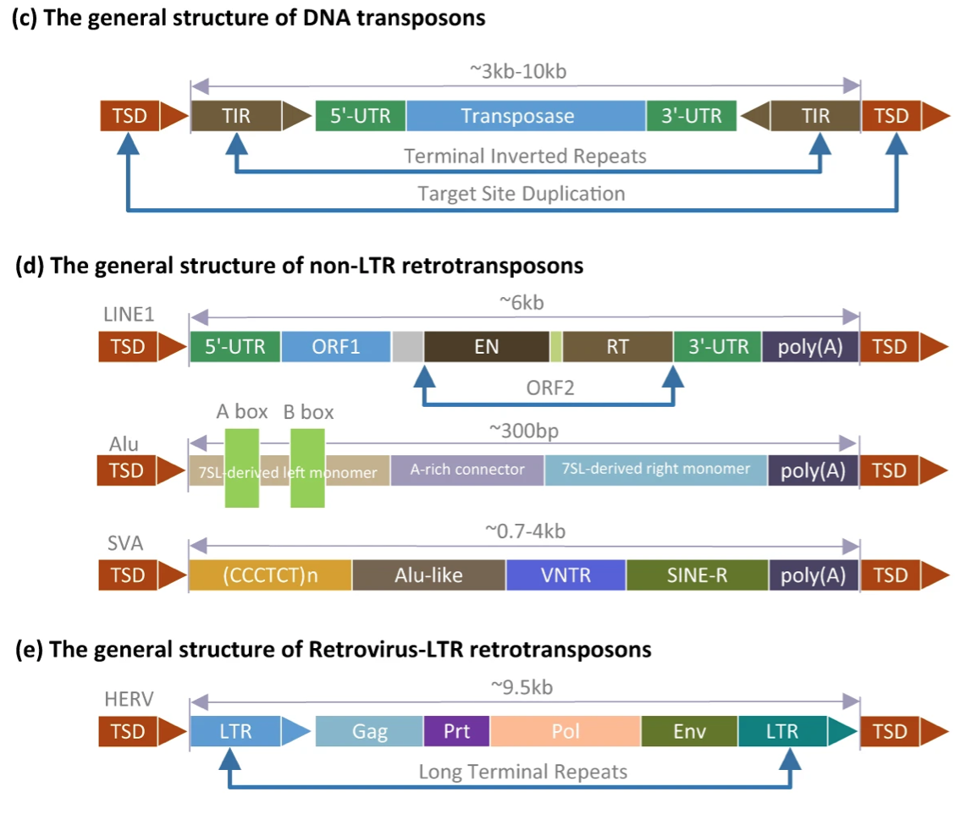
Interspersed repeats (transposons)
DNA transposons and RNA transposons (retrotransposons)
Liao et al., Communications Biology, 2023; DOI: https://doi.org/10.1038/s42003-023-05322-y
Notes:
(c): Typical structure of DNA transposons, in which TIR and TSD respectively represent the terminal inverted repeat and target site duplication. Sub-graph (d): Typical structure of non-LTR retransposons, in which the color blocks represent the protein domains contained in each family, and the gray block represents the non-coding regions. Sub-graph (e): Typical structure of retrovirus-like LTR retrotransposons, in which LTRrepresents the long terminal repeat.
Terminal inverted repeat sequences (TIRs); Target site duplication (TSD); Long terminal repeats (LTRs); Long interspersed nuclear elements (LINEs), Short interspersed nuclear elements (SINEs);

Slide 48
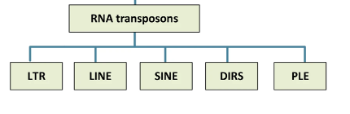
Common families of retrotransposons
LINEs + SINEs +LTRs:
>40% of the human genome!
SINEs (Short interspersed nuclear elements)
~300bp, non-autonomous non-LTR retrotransposons
depend on LINEs for their transposition
LINEs (Long interspersed nuclear elements)
autonomous non-LTR retrotransposons (LINE1 ~6kb)
have an internal promoter that drives the expression of transposition machinery, including reverse transcriptase and an endonuclease
LTRs (Long terminal repeats)
5–10 kb
characterised by having long terminal direct repeats
DIRS (Dictyostelium intermediate repeat sequence)
PLEs (Penelope-like elements)
Liao et al., Communications Biology, 2023; DOI: https://doi.org/10.1038/s42003-023-05322-y
Finnegan, Current Biology, 2012; DOI: https://doi.org/10.1016/j.cub.2012.04.025

Slide 49
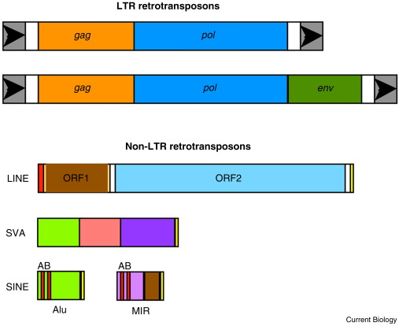
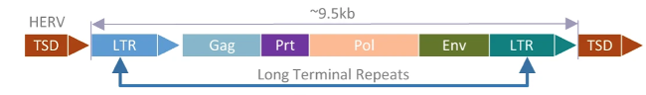
SINEs / LINEs / LTRs
Structure
Examples
Finnegan, Current Biology, 2012; DOI: https://doi.org/10.1016/j.cub.2012.04.025

Slide 50
SINEs / LINEs / LTRs
Junk DNA? NO
Functions? YES, although not entirely clear yet
Some examples:
The establishment of chromatin states necessary for development in preimplantation mouse embryos, by the transcriptional activation of distinct LTR and LINE elements
The maintenance of telomeres in Drosophila, by specific non-LTR retrotransposons
The use of LTR enhancers to regulate central genes in human innate immunity pathways
Gorbunova et al., Nature, 2021; DOI: https://doi.org/10.1038/s41586-021-03542-y

Slide 51
SINEs / LINEs / LTRs
Can they participate in disease mechanisms?
YES
Often they are silenced--but when they become active and mobile (somehow and sometimes), they may move from one genomic location to another, which could cause trouble.
> 120 LINE-1-mediated insertions were reported resulting in genetic diseases, such as Duchenne muscular dystrophy and X-linked severe combined immunodeficiency.
With aging, the suppression and silencing of retrotransposons will be weakened, implicated in some age-related disorders, such as neurodegenerative disorders and cancer. The exact causal mechanisms are not clear.
In cancer, activation of L1 would trigger interferon and promote cell death, while inflammation may also promote cancer by inducing cell proliferation.
Alzheimer’s disease: retrotransposon expression was positively associated with neurofibrillary tangle burden in human cortical samples. Sporadic Alzheimer’s disease has been associated with the insertion of processed pseudogenes of amyloid precursor protein (APP) into adult neuron genomes in a process that required reverse transcriptase activity.
Hancks & Kazazian, Mobile DNA, 2016; DOI: https://doi.org/10.1186/s13100-016-0065-9
Gorbunova et al., Nature, 2021; DOI: https://doi.org/10.1038/s41586-021-03542-y

Slide 52
Summary
Chromosomes
Bases and variation
Protein-coding genes; central dogma
Noncoding regions: pseudogenes, ncRNA, etc.
Repeats

Slide 53
Sometimes…
The cause and the solution may lie in the same place
If you look close enough.

Slide 54
Spinal muscular atrophy, SMA脊髓性肌萎缩症
症状：运动神经进行性损坏，肌肉进行性萎缩，进而导致运动、进食、呼吸困难。发病率1/6000-1/10000。
有多种亚型，症状可很轻微，严重的则可2岁内致死（如不治疗）。轻症型可能青春期成年期才发病。
Science Translational Medicine, 2020
https://med.sina.com/article_detail_103_2_86879.html

Slide 55
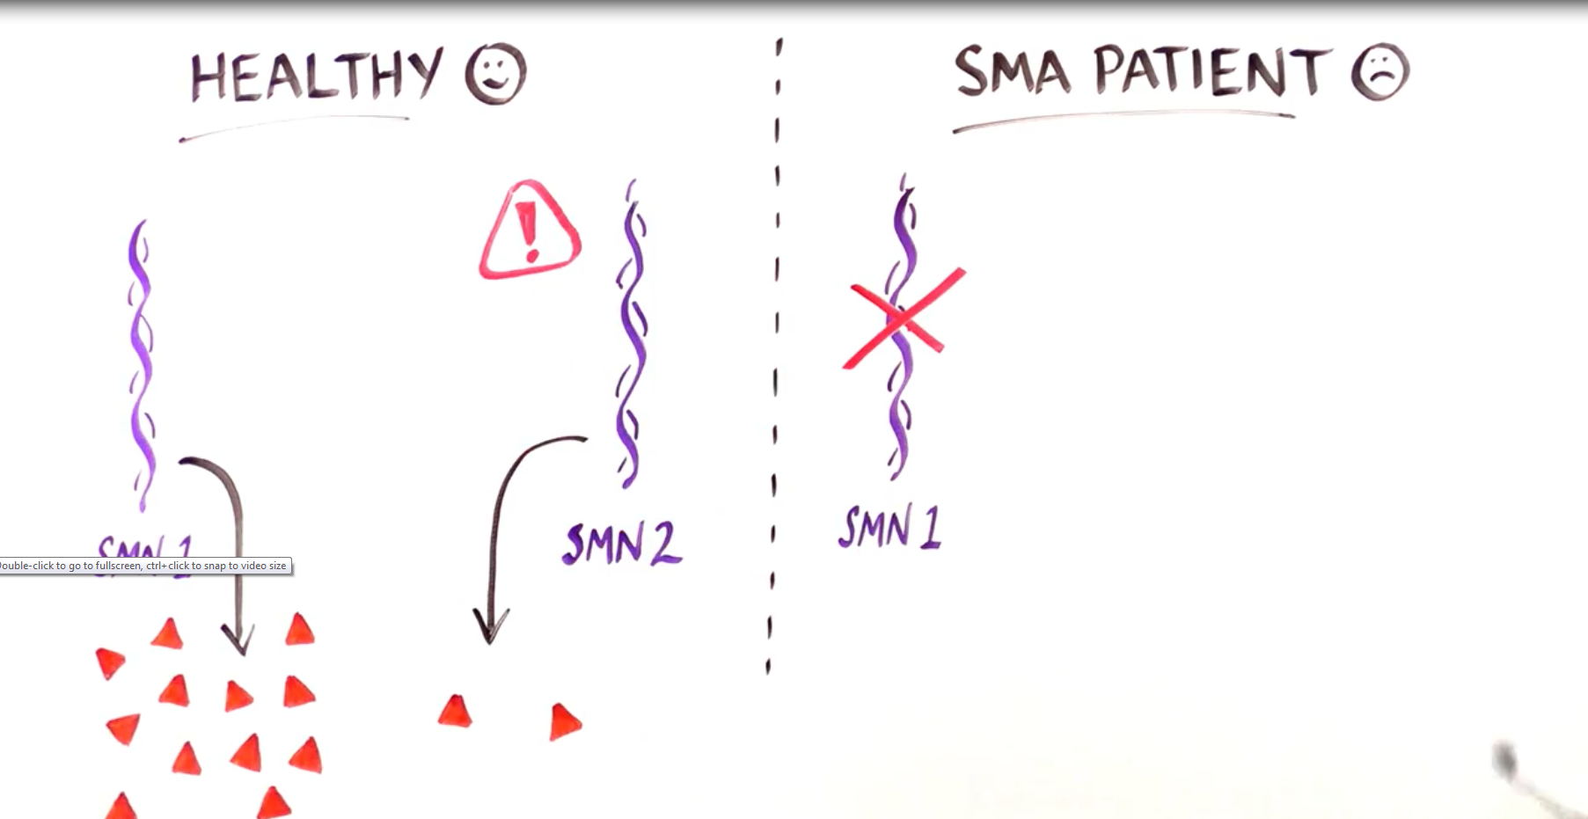
Spinal muscular atrophy, SMA
病因：SMN1基因失活突变（常染色体隐性遗传），此基因编码survival motor neuron（SMN）蛋白
人体另有数个拷贝的SMN2基因，也编码此蛋白，但是有同义突变导致可变剪接，只有约20%的情况下产生有功能的蛋白
在SMN1突变的病人中，基因组中SMN2基因的拷贝数，决定了病型和症状轻重，拷贝数多则症状较轻
其他病因：尚有一些其他基因的突变也可导致SMA，如 VAPB, DYNC1H1, BICD2, 和UBA1
Science Translational Medicine, 2020
https://med.sina.com/article_detail_103_2_86879.html
https://www.sandiegouniontribune.com/92202909-132.html

Slide 56
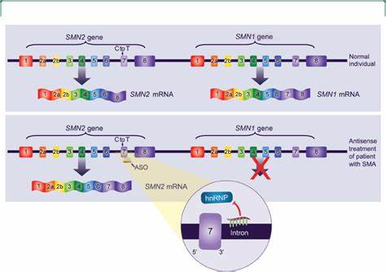
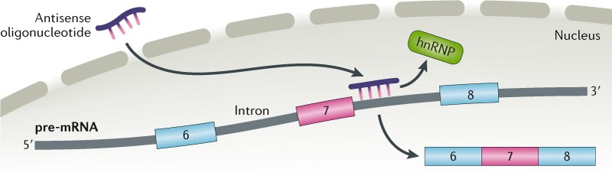
Spinal muscular atrophy, SMA
药物：Spinraza, 一种antisense oligonucleotide，针对RNA，需终身用药
针对SMN2而非SMN1:
以不变应万变
Boston Children’s Hospital
Nature, 2019

